Slide 1
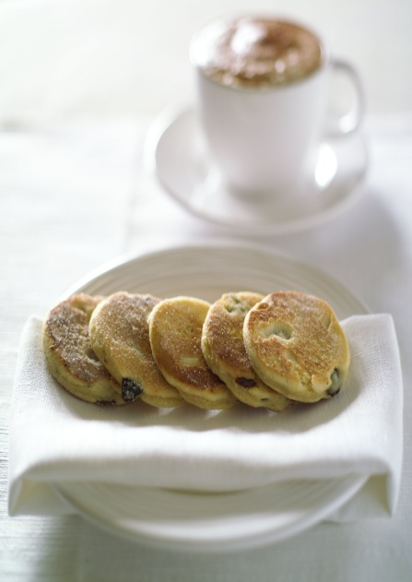
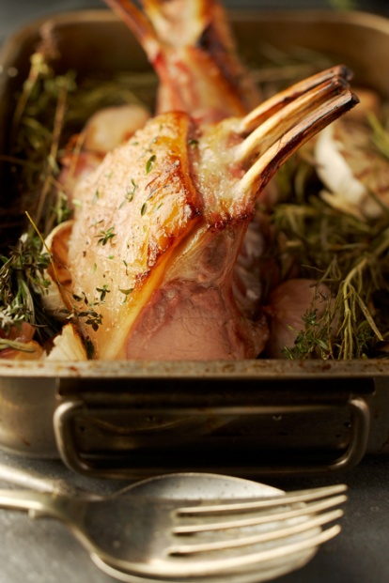
Food Skills Cymru
Lantra

Slide 2
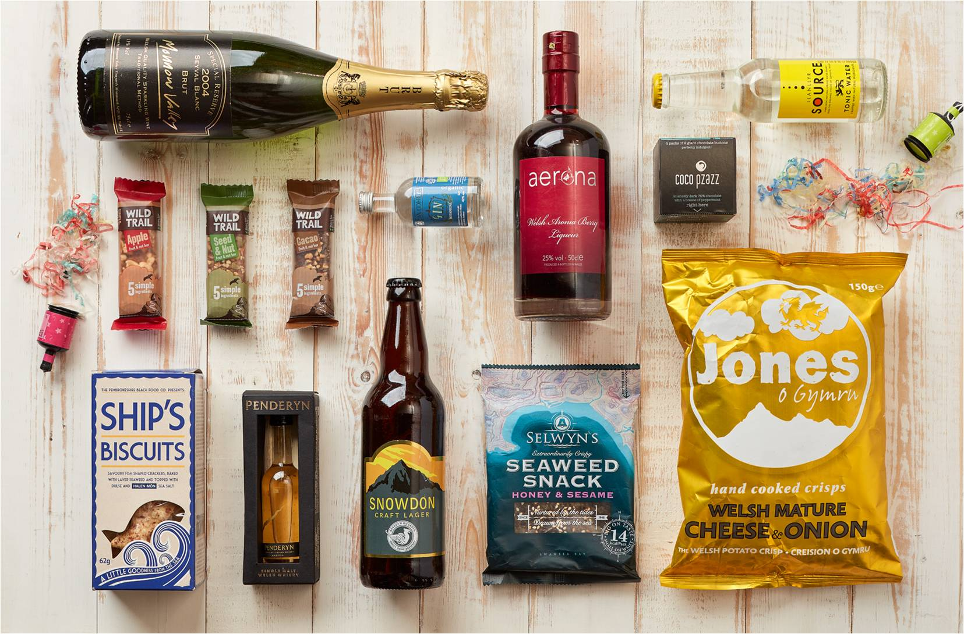
Supporting businesses to source, sell and serve Welsh food and drink
Cefnogi busnesau I brynu, gwerthu a gweini
bwyd a diod o Gymru

Slide 3
Sian Roberts
Logo Loving

Slide 4
Aims
Pwrpas
How to continue to provide excellent customer service
How do we do that in post Covid – 19 situation?
Top tips

Slide 5
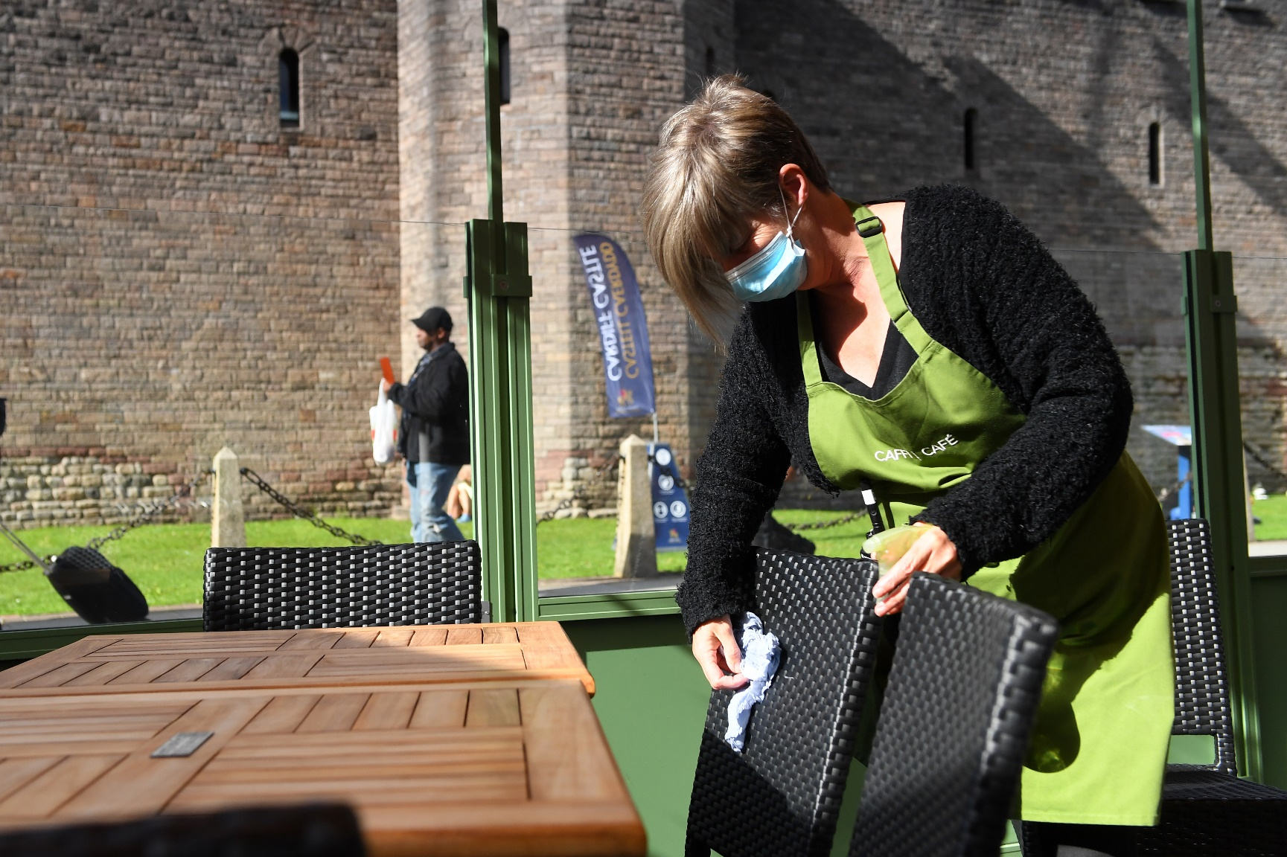
Customer Service
Gwasanaeth Cwsmer
Recent research
Flexibility
Staff training
Communication

Slide 6
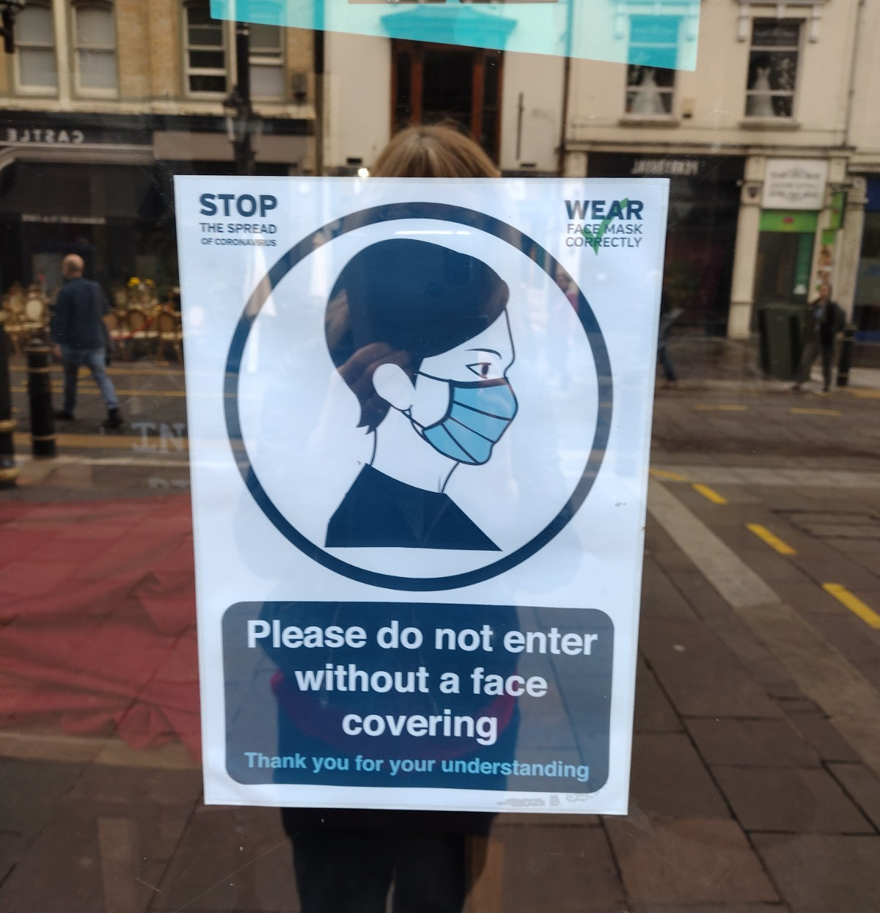
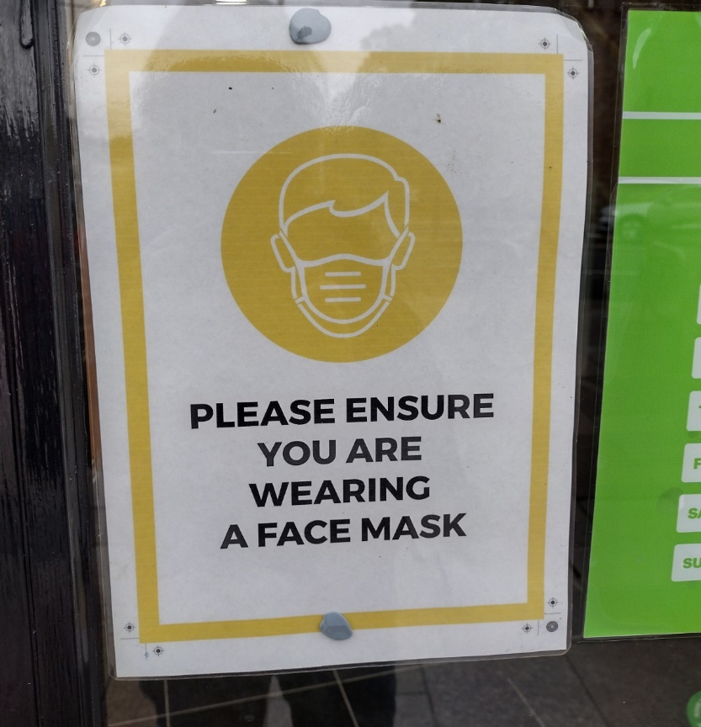

Slide 7
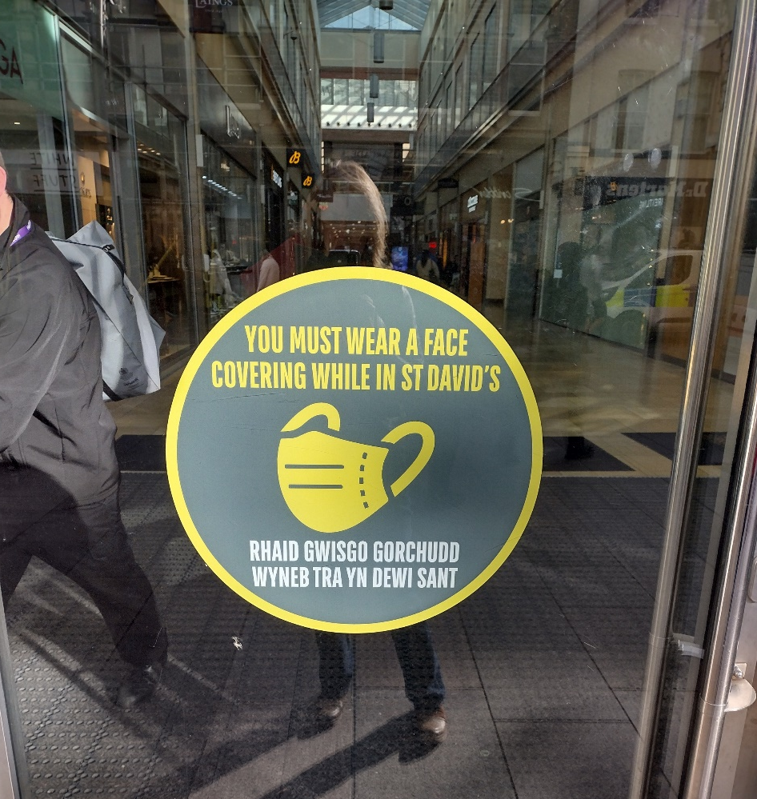
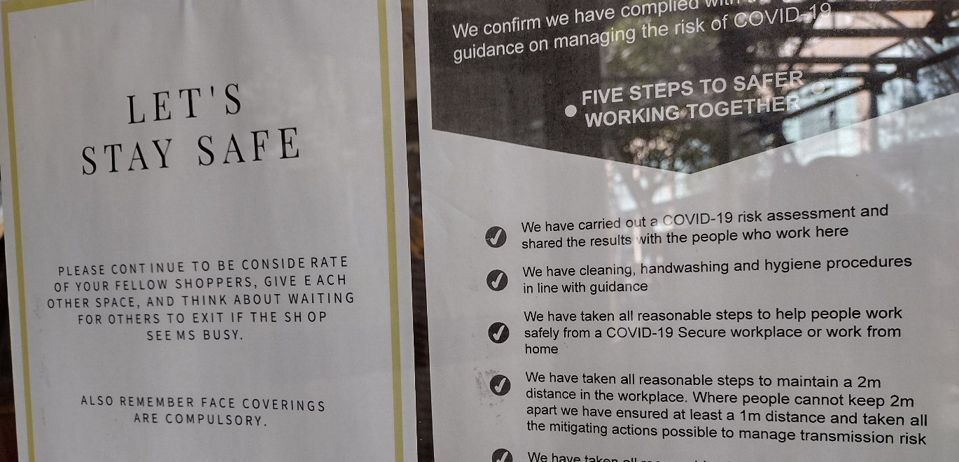

Slide 8
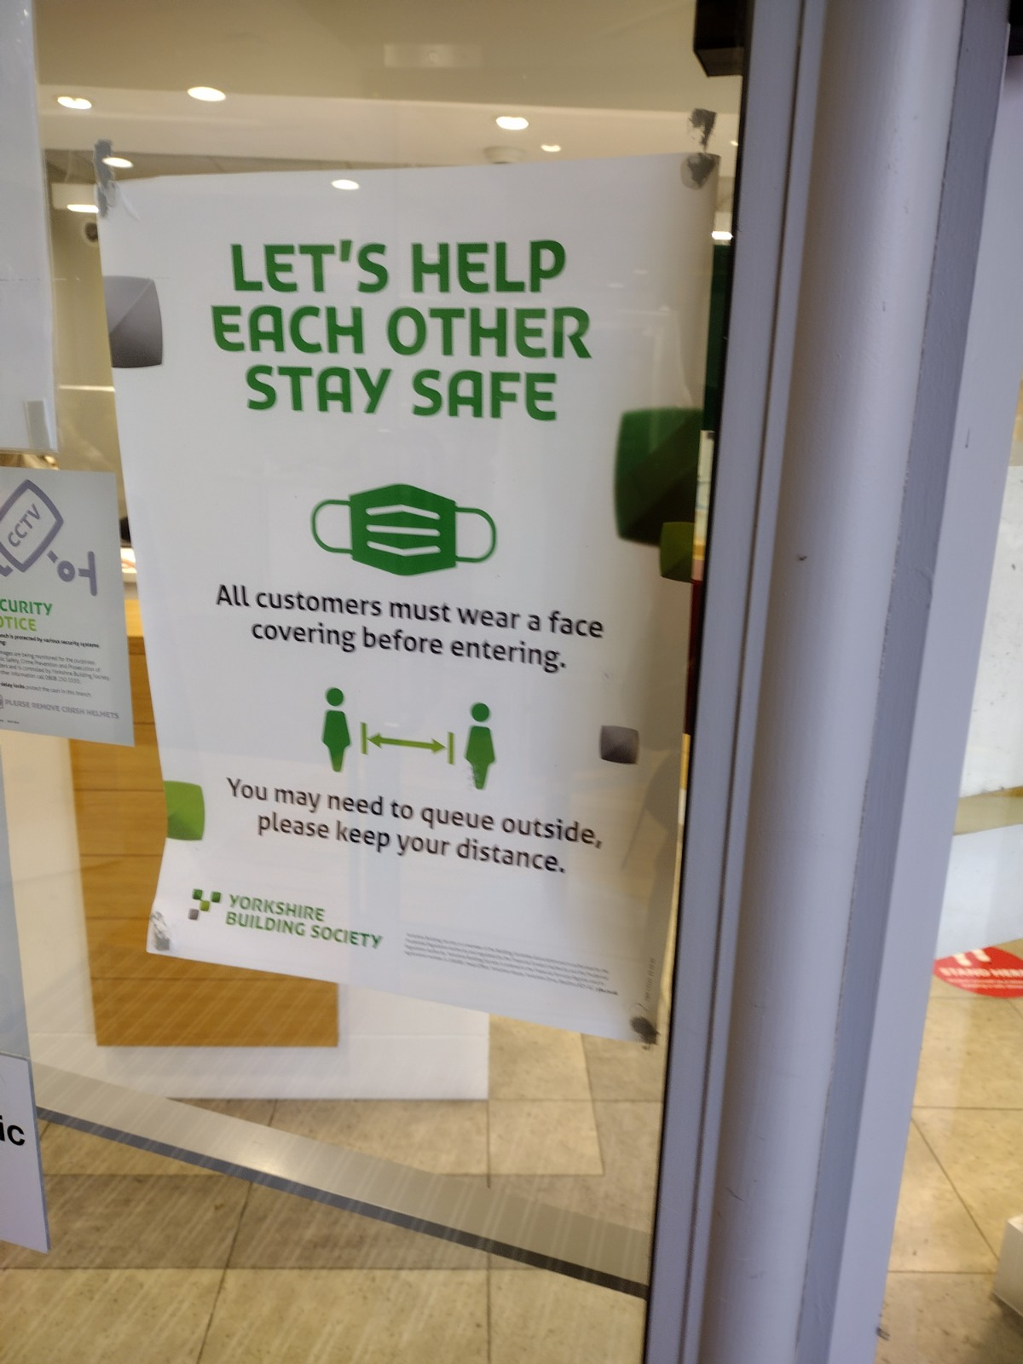
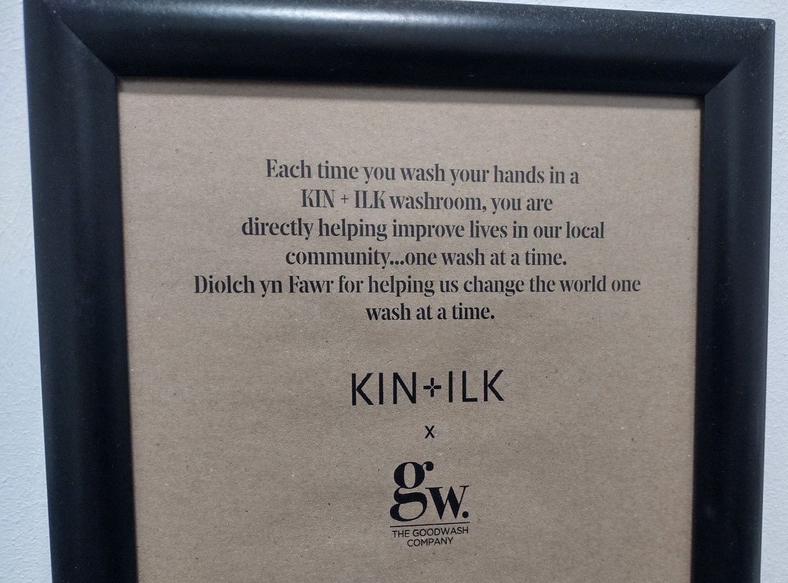

Slide 9
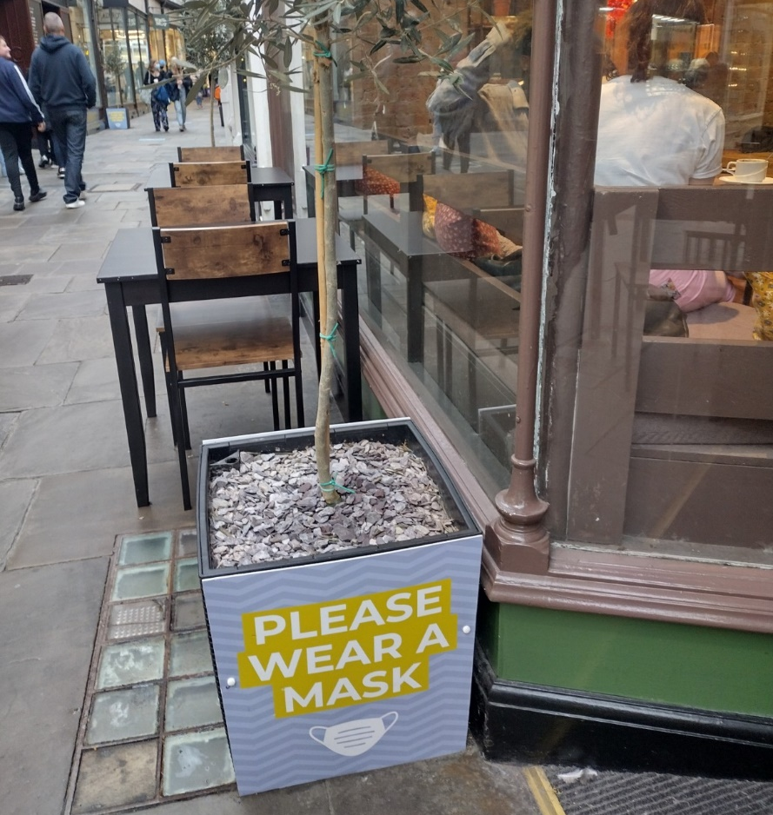
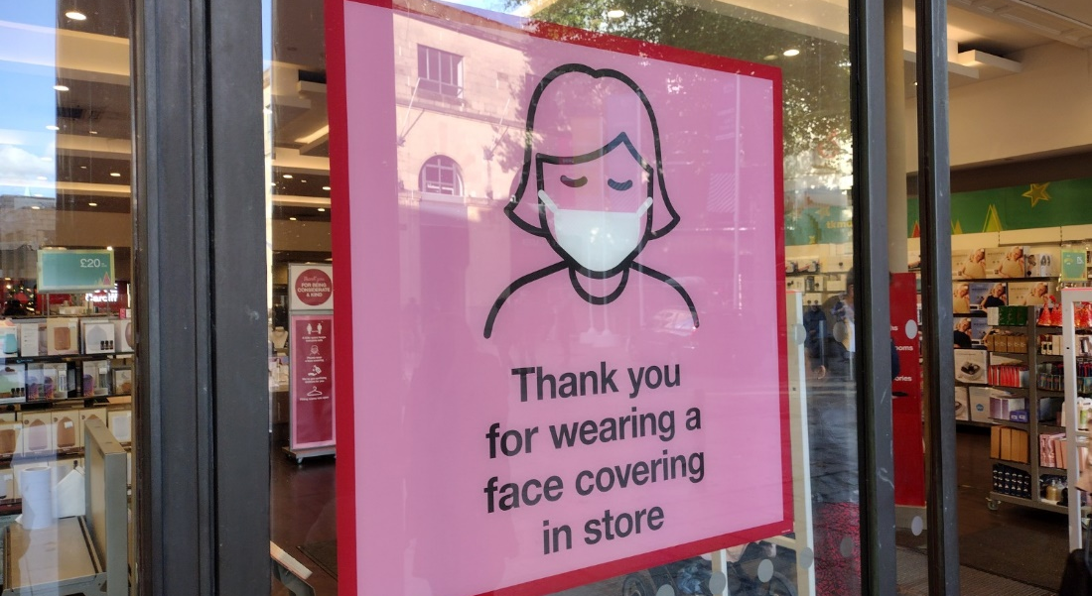
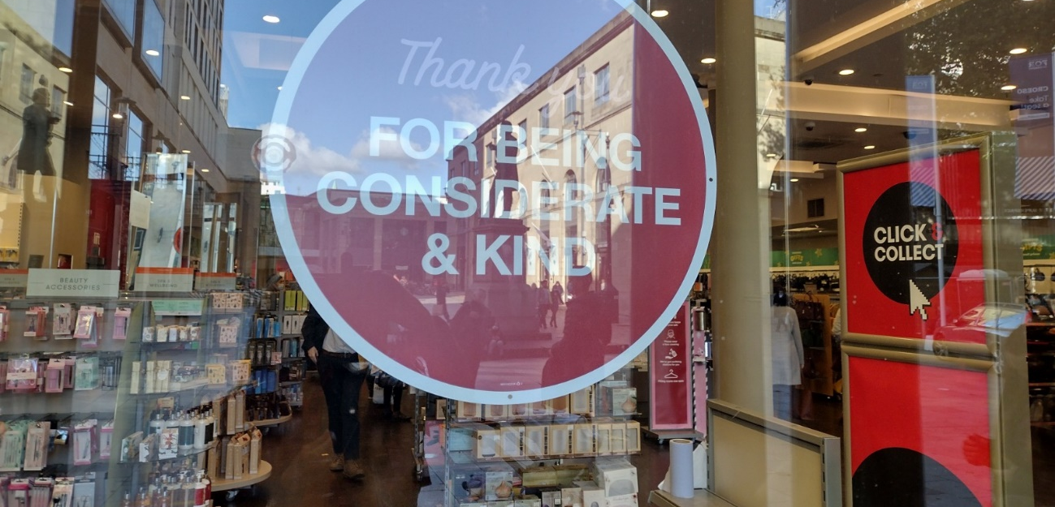

Slide 10
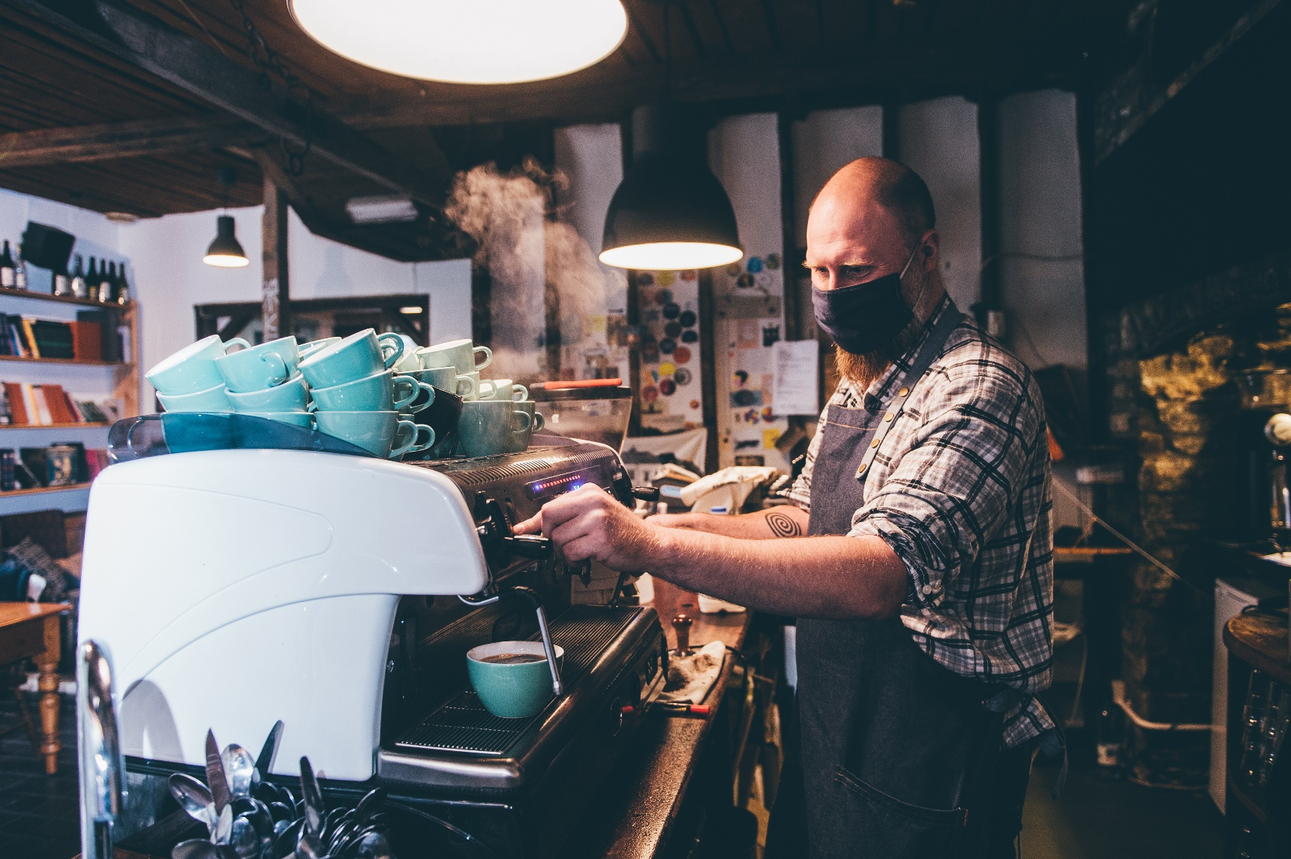
Role play
Enghraifft
The mask challenge

Slide 11
Suggestions
Awgrymiadau
I’m sorry can you speak up a little?
Apologise and offer a solution
Check the order
Write it down and repeat to customer

Slide 12
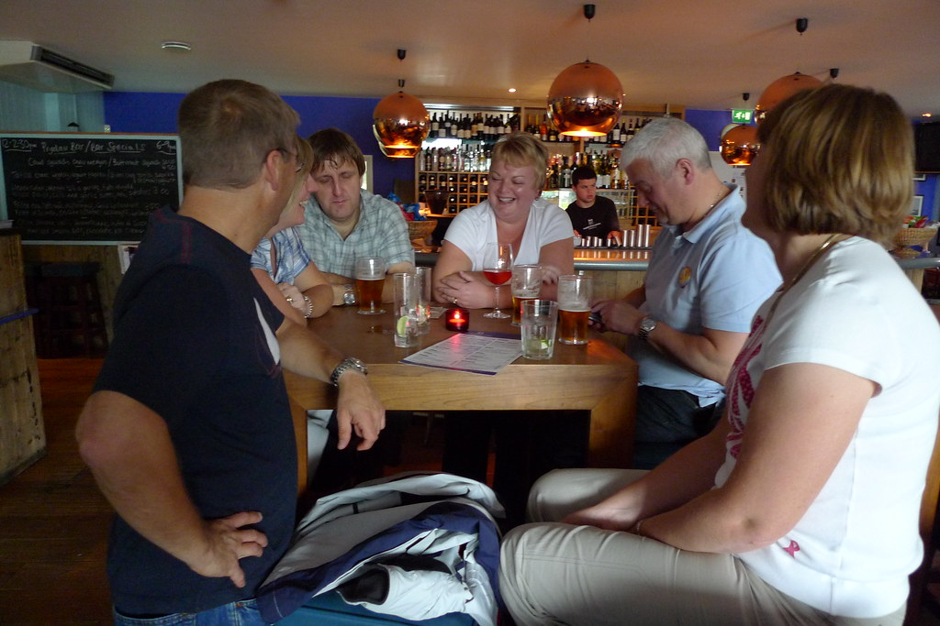
Role play
Enghraifft
Staffing issues
This Photo by Unknown Author is licensed under CC BY-NC-ND

Slide 13
Suggestions
Awgrymiadau
Warn guests beforehand that service may be affected
Thank them for their patience
Protocol – e.g offer a free drink/voucher to return

Slide 14
Role play
Enghraifft
Food shortages

Slide 15
Suggestions
Awgrymiadau
Inform them what is not available on the menu before ordering
Recommend other dishes
Apologise and explain dishes are cooked fresh, daily deliveries etc

Slide 16
Be honest
Be available
Listen to your customer
Be flexible
Be generous
Don’t apologise for things that are out of your control
Don’t try and justify/explain the situation

Slide 17
Customer service Top Tips
Awgrymiadau gwasanaeth cwsmer
Smile! 😊 First impressions are lasting impressions
Look after your customers –explain Covid-19 protocols
Be aware - make eye contact with all customers.
Develop relationships
Make them feel special
Clear communication
Look good – be clean and tidy
Product knowledge
Up sell where possible
Prompt payment
The way you say goodbye is as important as the first impression.

